Slide 1
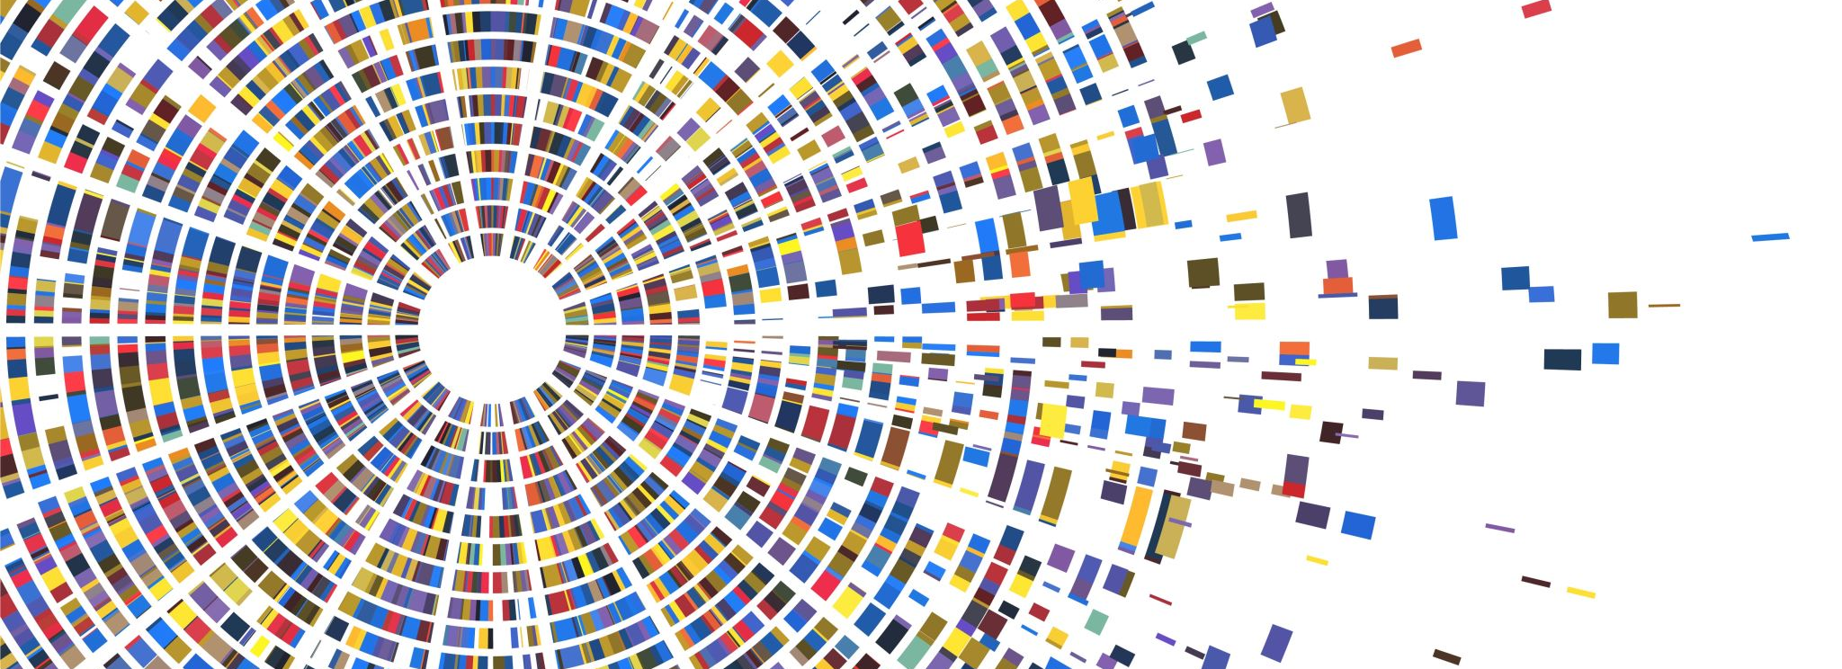
Attention Deceptive Designs in Digital Interfaces
Muhammad Raees
mr2714@rit.edu

Slide 2


Slide 3
How did it go
How many passes?
13
Did you see the moon-walking gorilla?

Slide 4


Slide 5
Outcomes
First Timer
If you notice a gorilla – you are distracted easily
Repeater
You already know what to look for
If you are focused. You will not know what is going on around you.
The key to focus is to have only information in display that captures attention.
http://www.theinvisiblegorilla.com/gorilla_experiment.html

Slide 6
Objective
Given, design mechanisms and patterns for attention deception, students should be able to identify (list down) attention deceptions in interfaces and (potentially) propose remedial designs that value user trust where the remedial design should be free of any deception pattern when compared with the original one.

Slide 7
Outline
What makes a design deceptive
Methods for deceptive design
Patterns of deceptions
General guidelines to avoid deceptive design

Slide 8
A Good Design: Review
A good design captures the attention to inform a user of possible actions.
Designers are responsible for making the design
Functional
Honest
Lawful
Regulations (now, and upcoming) audit designs for deceptive behaviors.

Slide 9
A Deceptive Design
Attention capture by designs a.k.a. “dark patterns” diminish people’s sense of agency and control.
Intentionally manipulate users into performing actions that go against their best interest to extract
Money
Data
Attention

Slide 10
A Deceptive Design
Analysis of 53,000 pages from 11,000 websites showed that 11% of the sites featured designs that were
Aggressive
Misleading
Deceitful
Potentially unlawful
A Study by Princeton University on dark patterns.

Slide 11
Can you recall any deceptive design/pattern that you have observed while using apps/web?

Slide 12
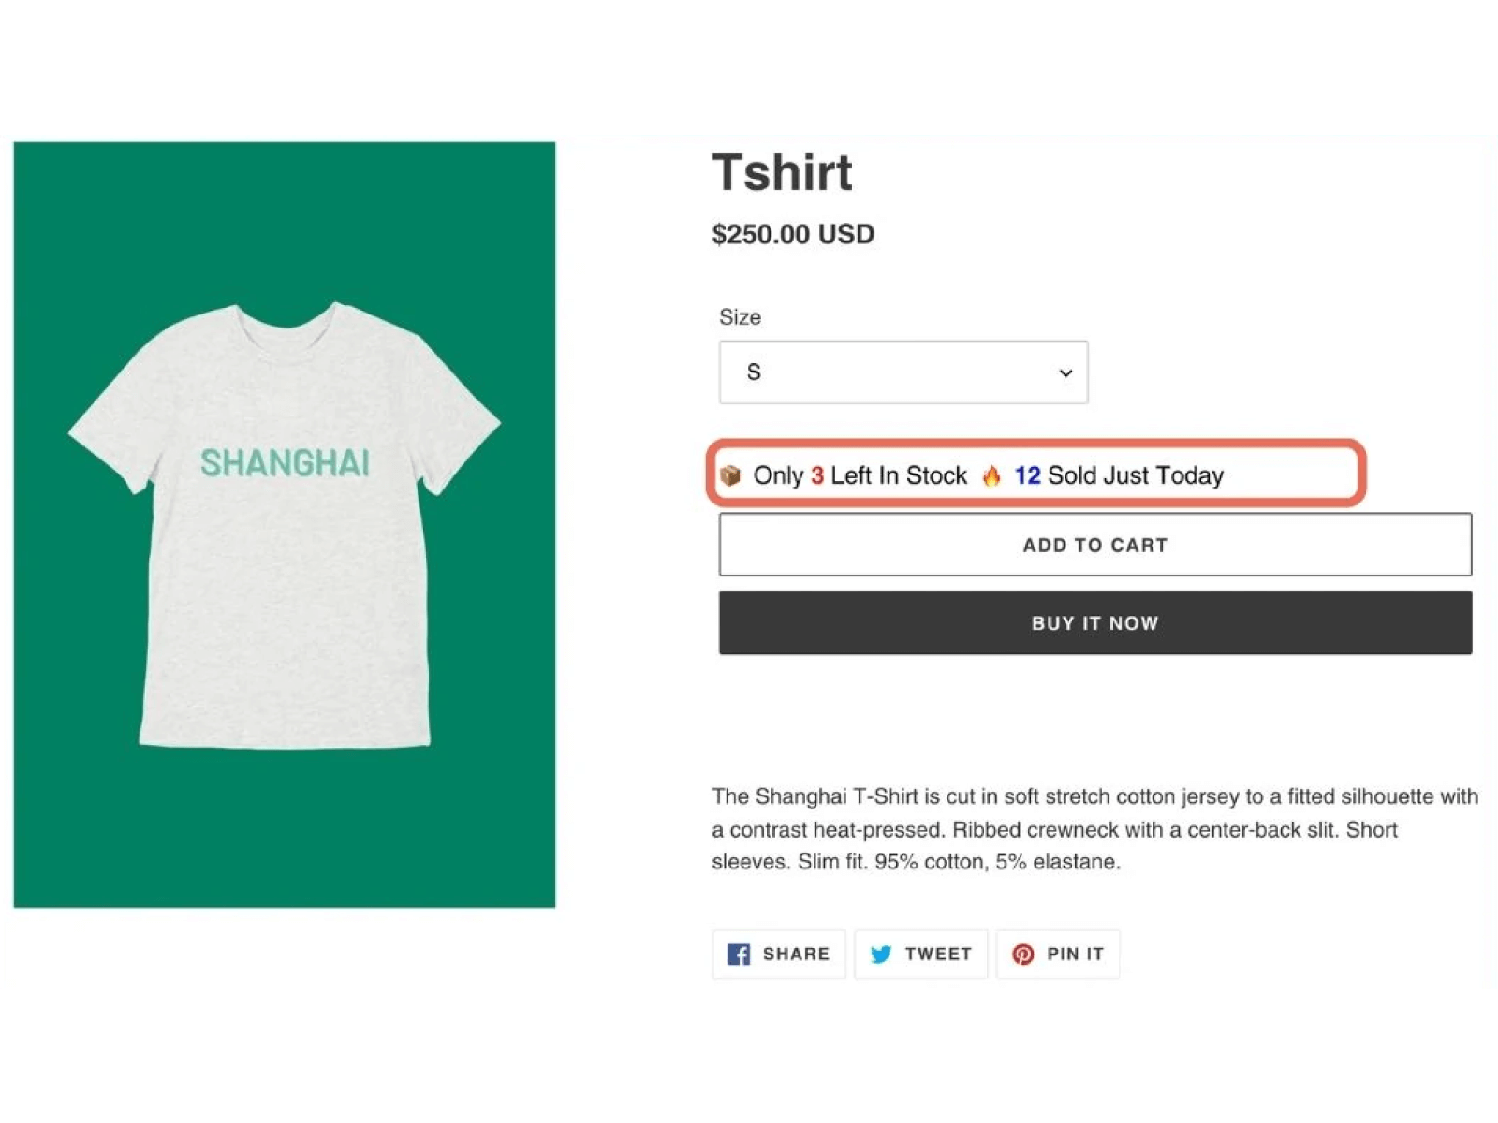
The Shopify app “Sales & Stock Counter” is made by a company called HeyMerch.

Slide 13
Deceptive Mechanisms
Specialized mechanisms targeted for attention.
Methods
Automate User Experience
Exploit Psychological Vulnerabilities
Impact
Lost sense of agency
Lost perception of trust

Slide 14
Deceptive Design Method Automate User Experience
Improving user experience is beneficial but can also be used for deception.
Pre-selected defaults
Compulsion Loops.
Obstruction of Information
Hiding controls.
Auto-play.

Slide 15
Deceptive Design Method Psychological Vulnerabilities
Immediate Gratification
Follow an intuitive path to avoid obstruction.
Scarcity and Urgency
Create fear of missing something.
Influence by actions of others.
Element of surprise
Hope for something new to appear → Uncertainty → Temptation.

Slide 16
Impacts of Deceptive Design
Agency Loss – Decreased perception of self-initiated actions.
Product/Content (forcefully) recommend
Pre-selected options
Information disguise
Lost Trust
Damage product/client reputation
Engagement, subscriptions, and purchases are negatively affected in the long run

Slide 17

Deceptive Design Patterns
Fake urgency
Roach Motel
Disguised ads
Hidden Costs
Obstruction
Visual Interference
More Abstract
Infinite Scroll
Pull-to-refresh
Play by Appointment
Auto-play

Slide 18
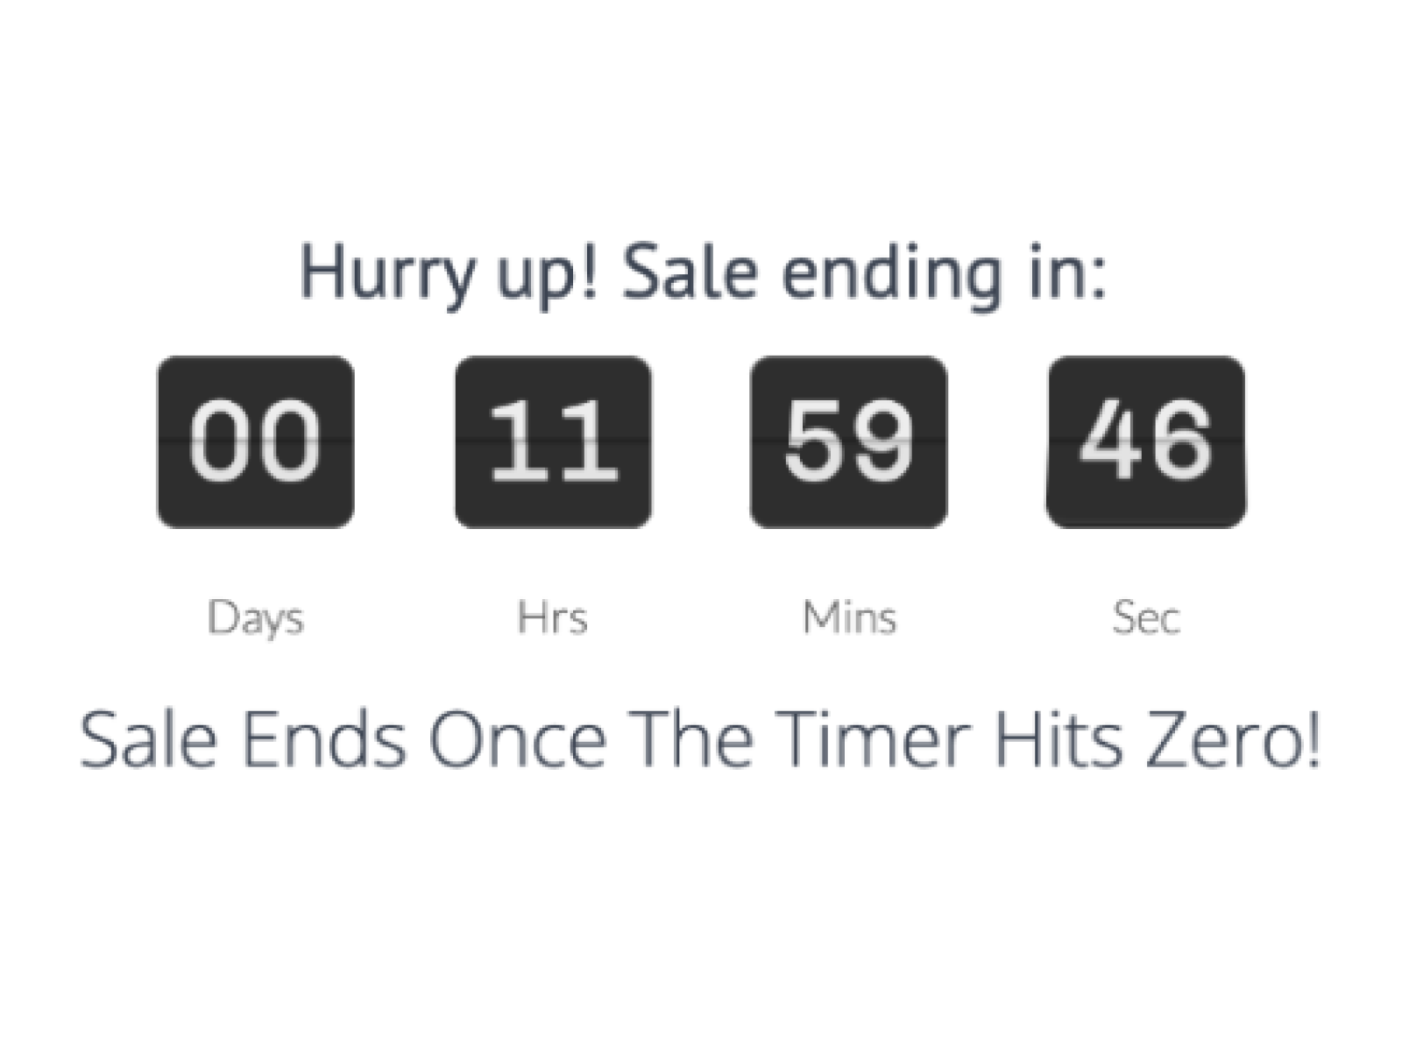
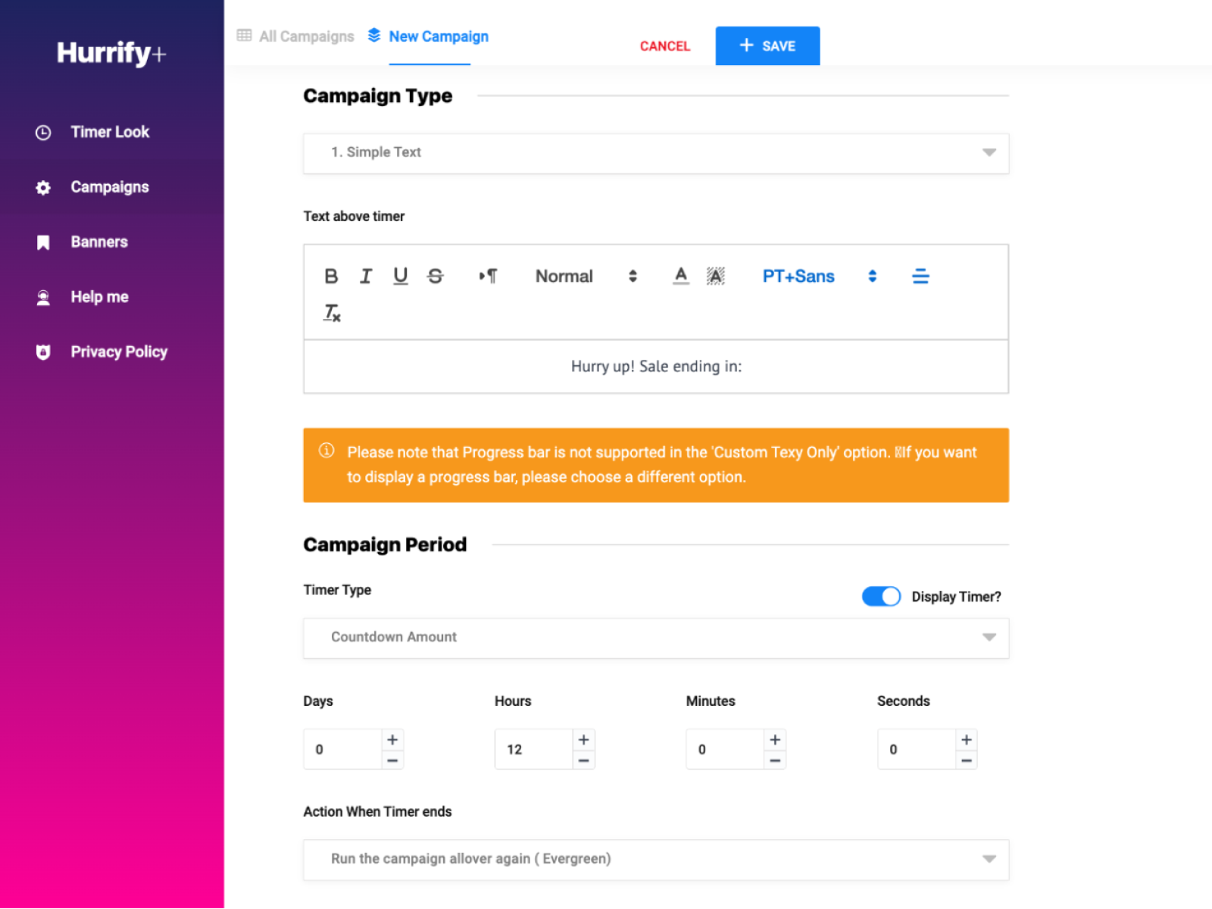
Fake Urgency
Create time pressure on user
“Hurrify” can be used to create various fake urgency messages, one of which is a fake countdown timer.

Slide 19
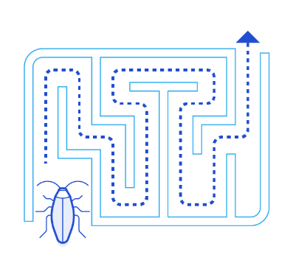
Roach Motel
Hiding options deep to delete your account.
Social Media
Prolong the process

Slide 20
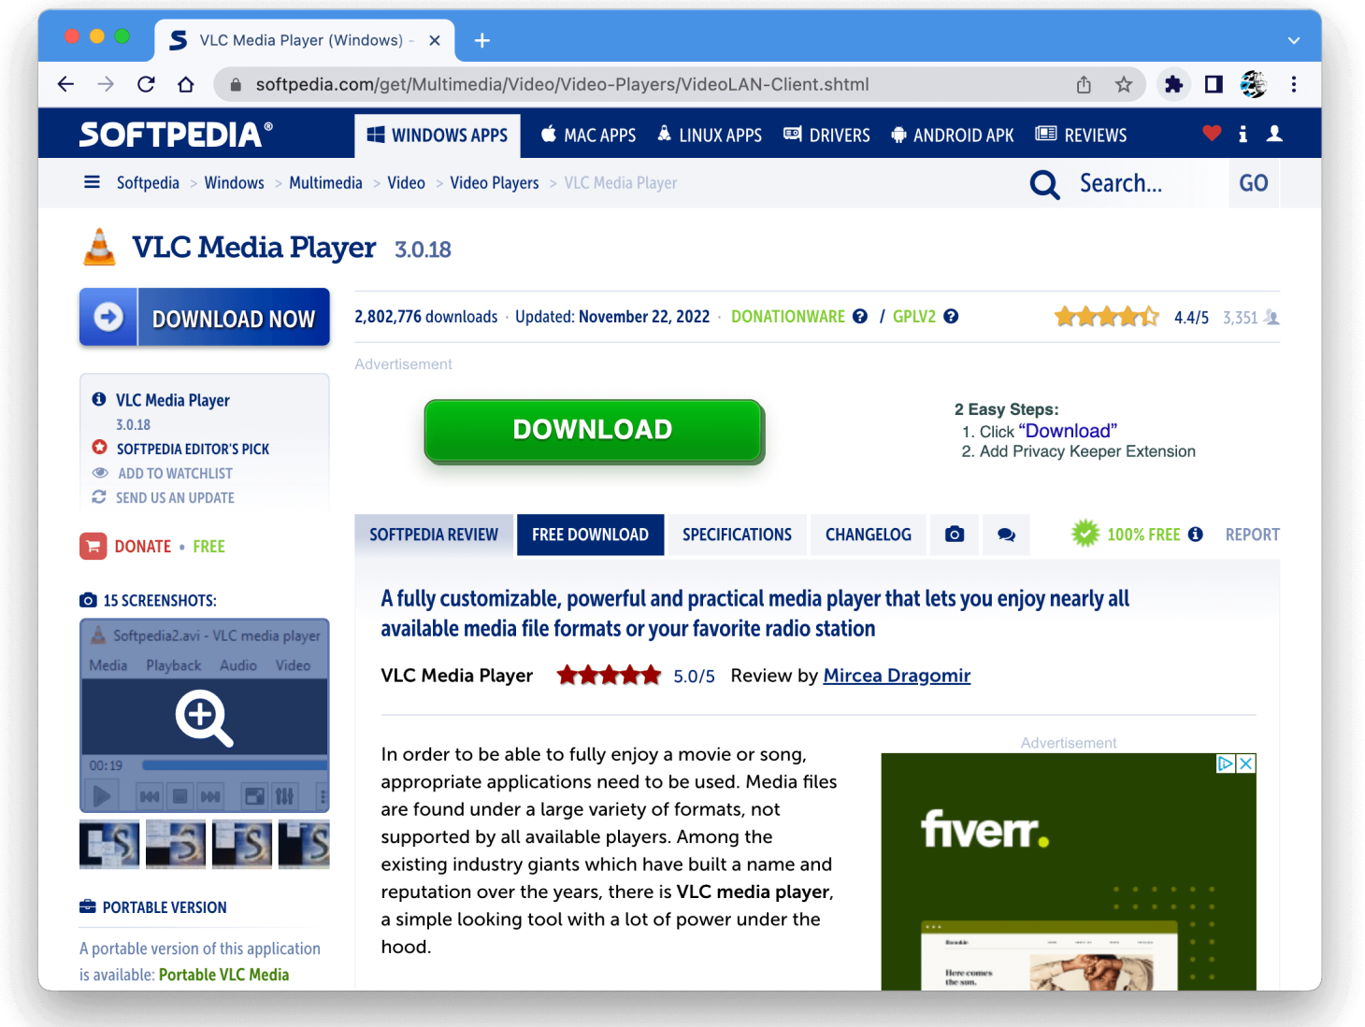
Disguised ads

Slide 21
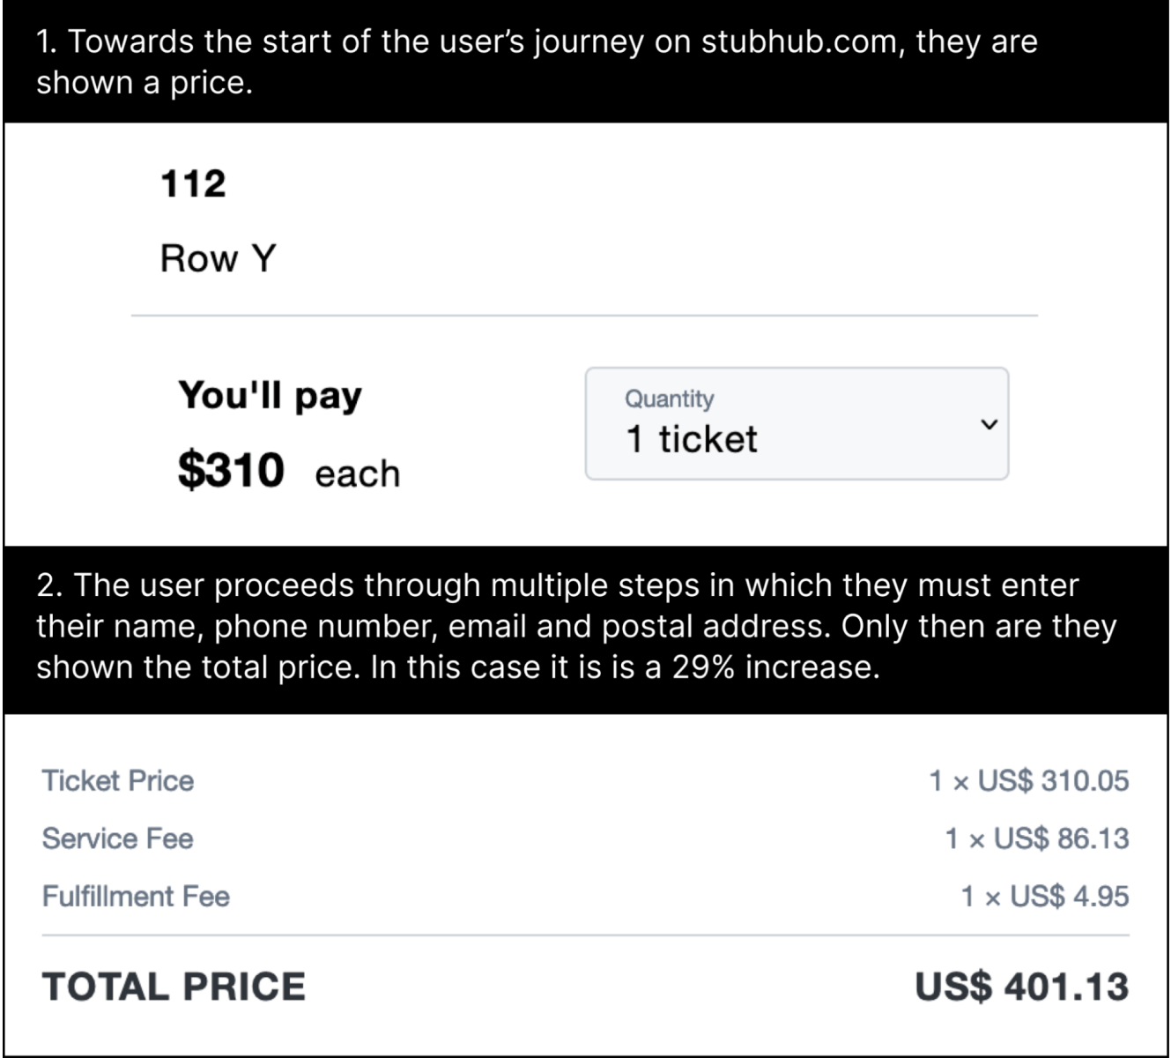
Hidden Costs
Obscuring or omitting additional fees, charges, or costs

Slide 22
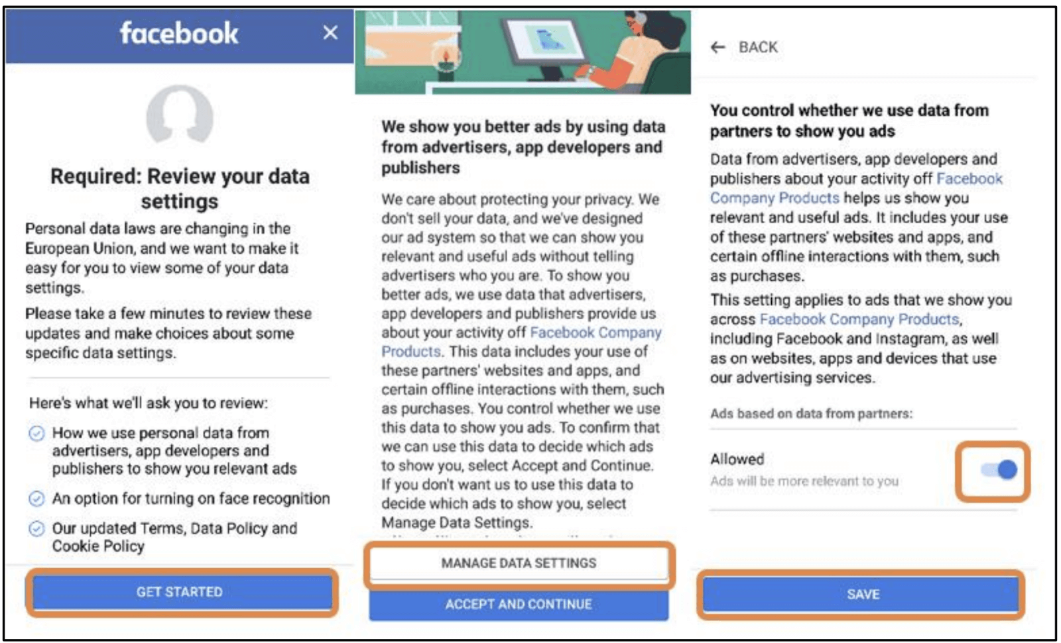
Obstruction
Deliberate obstacles make it difficult for users to take action

Slide 23
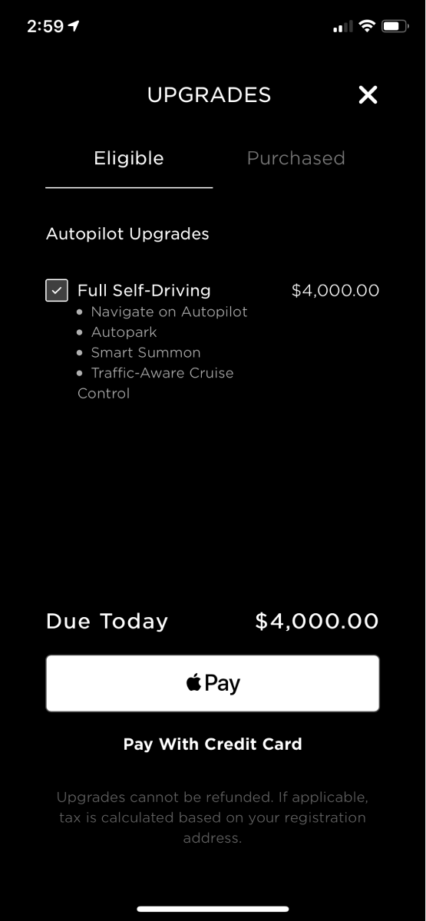

Visual Interference
Interfere with the visual design of a page to obscure, or disguise information.

Slide 24

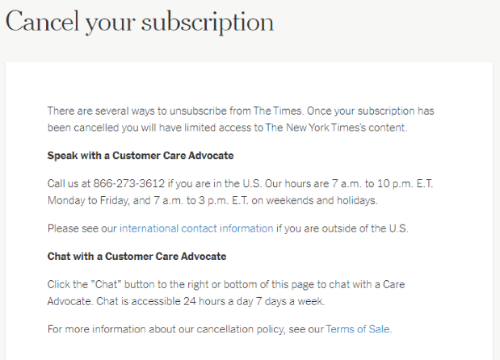
Can you identify a pattern

Slide 25
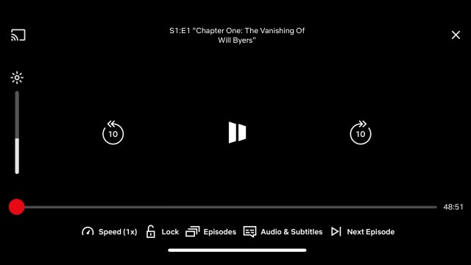
Can you identify a pattern

Slide 26
Why design without deception
Laws
In the EU, the UCPD, GDPR, DSA, and DMA help ensure a fairer internet for users.
In the USA, the FTC Act, ROSCA, and CAN-SPAM are major federal laws for users.
Financial Loss
Epic Games: $245M for using deceptive payment patterns.
Noom: $62M for using deceptive auto-renewal practice.
https://www.deceptive.design/laws
https://www.ftc.gov/system/files/ftc_gov/pdf/1923203epicgamesfinalconsent.pdf

Slide 27
How to design without deception
Start with user needs
Avoid deliberate deceptions
Beware of laws

Slide 28

User needs
Discovery
Find without search
Design should help find it
Filtering
Design should filter information by loading only what is needed
Memory
Limited resources – must be utilized effectively
Recognition over recall
Notes:
Self-discovery

Slide 29
Avoid Deliberate Deceptions
Evaluate interfaces with the checklist to identify deceptive patterns.
Audit damaging patterns with controlled experiments.
Conduct A/B testing for comparative analysis
Ensure the difference between ads and content.
Try to map the user’s psychological model.
Offer users to turn off deceptive patterns.
Turn off the recommendation

Slide 30
Task
Take a well-known interface (e.g., Facebook, YouTube, Netflix, Amazon, or any other).
Identify deception patterns
List down the identified patterns and mechanisms they utilize
Try eliminating deceptive patterns by providing a remedy for the design that does not affect the functionality.

Slide 31
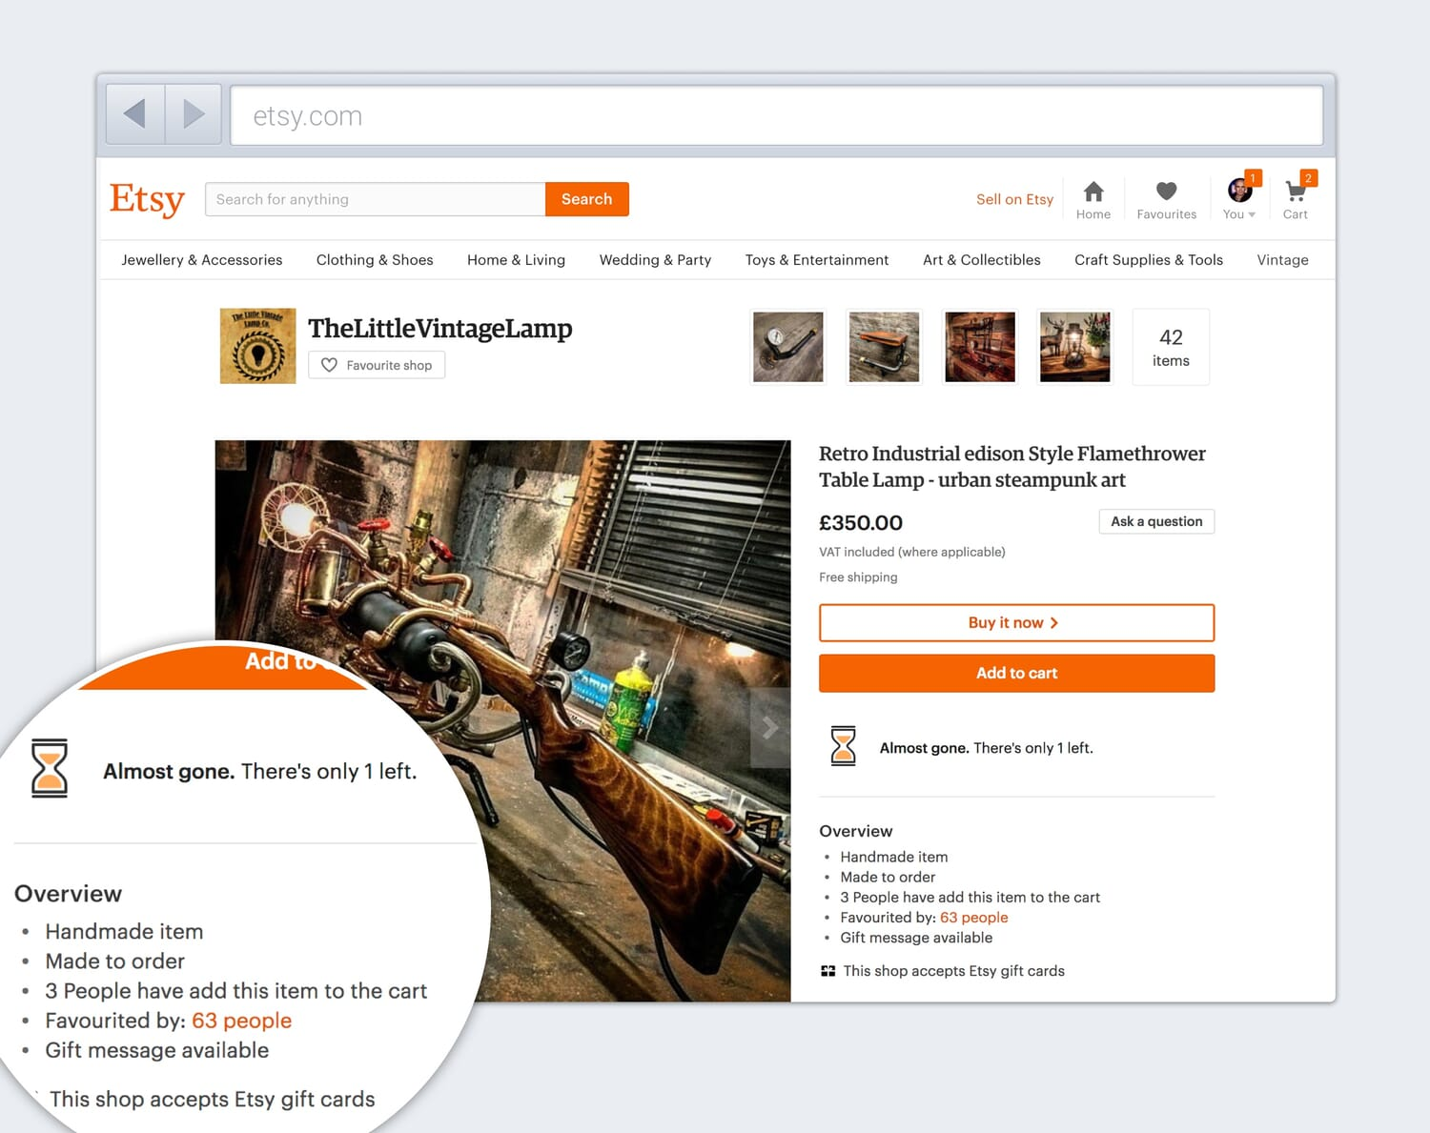
A simple example

Slide 32
Discussion
Trade-offs between business growth and valuing user attention → Regulations.
Dark patterns work but they are not the most effective approach – better to match the users’ mental model.

